Slide 1
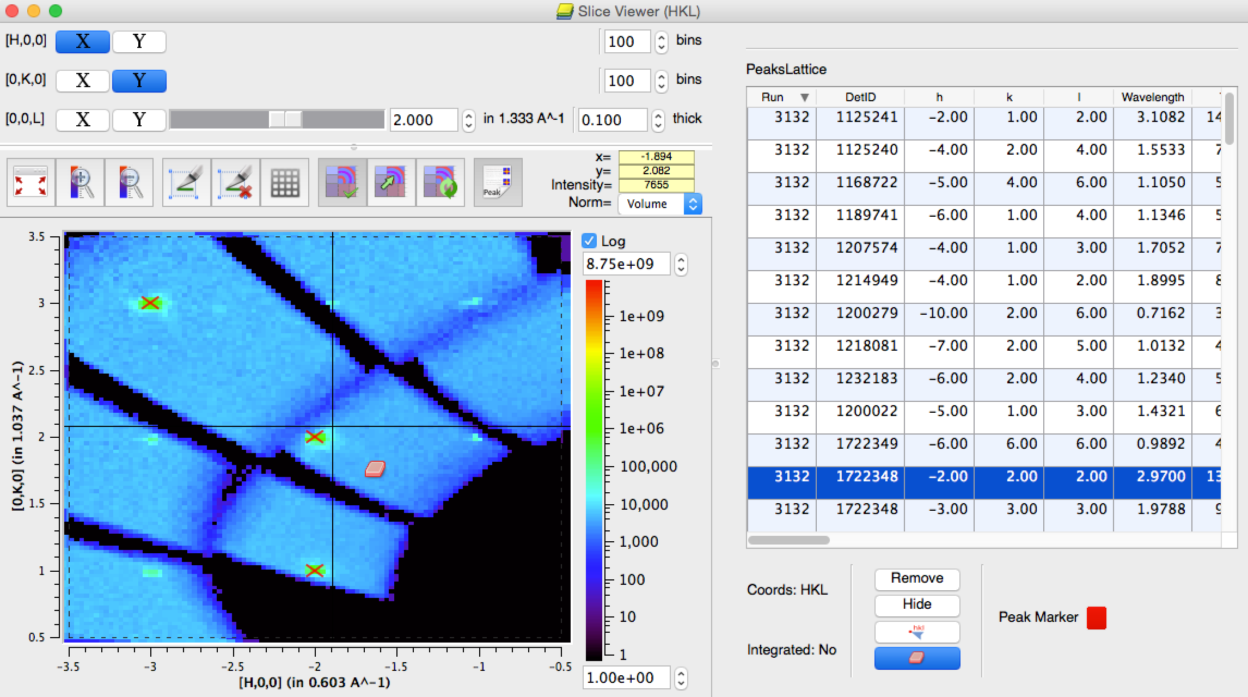
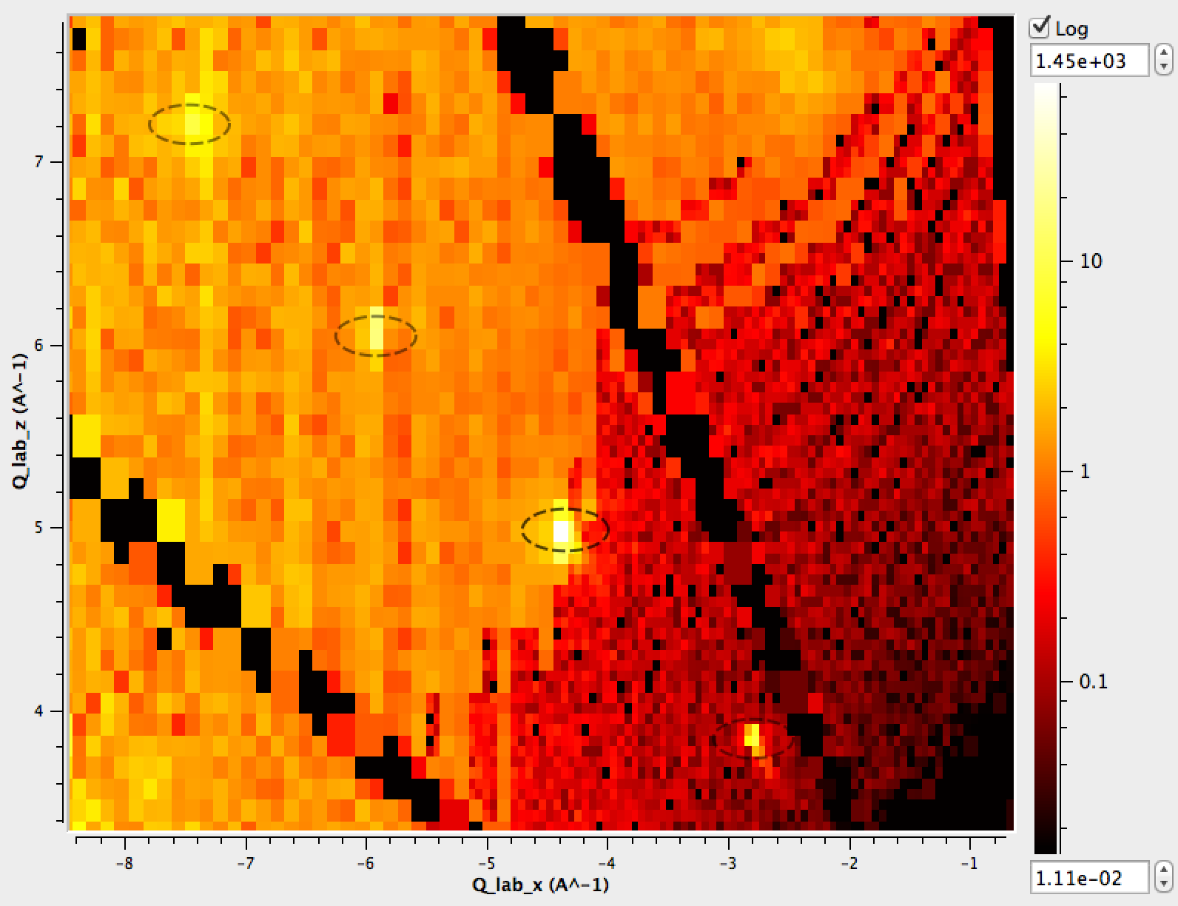
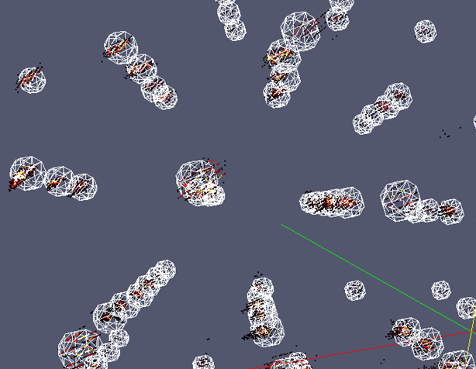
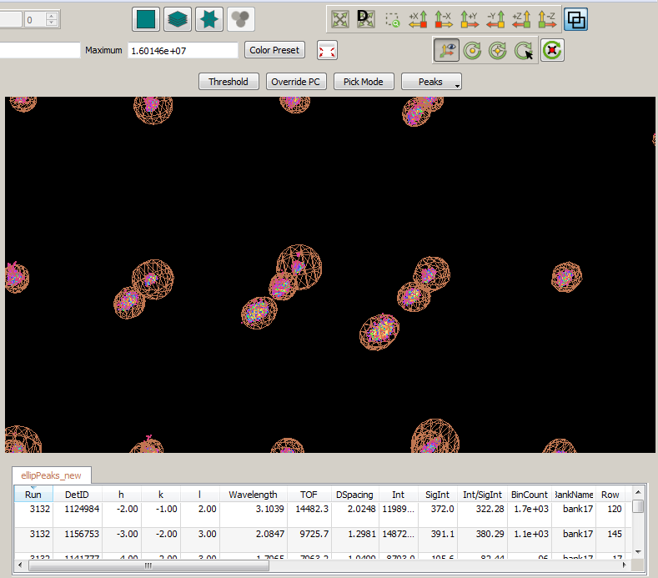
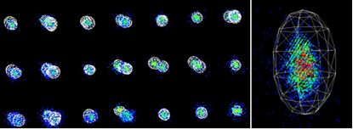
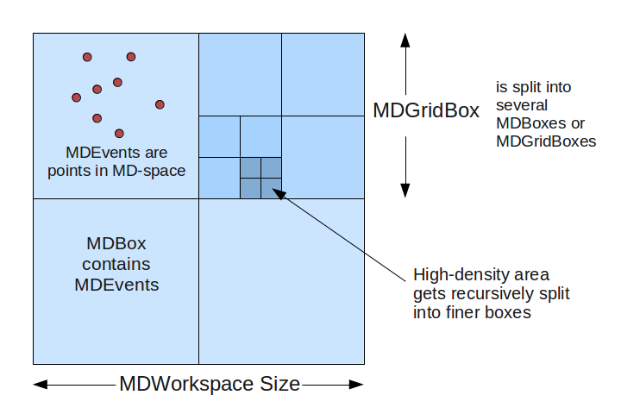
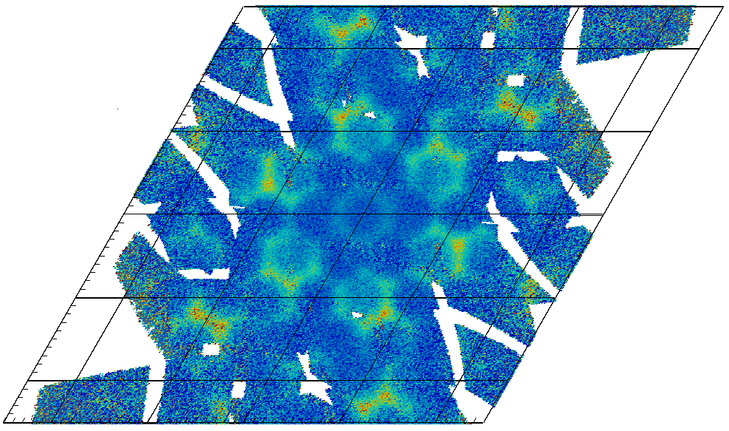





Visualisation and Analysis in Mantid for Single Crystal Neutron Diffraction
Owen Arnold¹, Nick Draper¹ Pascal Manuel²,
Andrei Savici³, Anton Piccardo-Selg¹, Martyn Gigg¹, Steven Hahn³, Vickie Lynch³, Alex Buts², Peter Peterson³, Stuart Campbell³, Toby Perring², Jon Taylor⁴
¹ Tessella, Abingdon, Oxfordshire, UK
² STFC Rutherford Appleton Laboratory, Oxfordshire, GB
³ Oak Ridge National Laboratory, Oak Ridge, Tennessee, US
⁴European Spallation Source, Lund, SE
Background Large neutron scattering datasets are commonly collected at time-of-flight (TOF) sources, particularly for single crystal diffraction experiments. Increasingly, and particularly in single crystal diffraction (SCD), the correct treatment of data, as part of data reduction and analysis, for a range of techniques, involves the efficient and flexible processing of large n-dimensional datasets. A collaborated effort involving ISIS at RAL, the SNS at Oak Ridge, and more recently the ESS in Lund, has focused on the computational aspects of single crystal diffraction data processing. Frameworks Mantid is an extensible framework for neutron and muon data reduction and analysis¹. The Mantid framework is mature and widely used across many facilities and technique areas. For n-dimensional visualisation, the Mantid project uses ParaView², an advanced VTK based visualisation engine. Mantid bundles a lean distribution of ParaView with each install. Mantid binds to ParaView via the introduction of n-dimensional data structures and algorithms. In addition, we utilise ParaView’s plugin mechanism to provide customised tools for neutron scattering. We also deliver two-way interaction between ParaView and Mantid so that users can visually drive the data reduction and analysis process. This has required engineering and innovations on both the Mantid and VTK side of the project. We have been working with Kitware, the developers of ParaView, to extend the capabilities of their visualization tools. Data Structures Mantid stores its data in structures known as Workspaces. Converting from TOF, detector-space to reciprocal space, as well as the need to consider sample environment conditions space has required the introduction of new Workspace types. Two n-dimensional workspace types have been introduced: A sparse workspace, based on an adaptive box structure, and a dense histogram workspaces based on a set of strided arrays. Both workspace types are necessary for SCD computations in Mantid. Our sparse workspace stores all observations in the specified dimension. These are stored in a tree structure to allow fast access. Crucially there is a dynamically determined structure, this means regions of low counts have a very low memory overhead, while regions where constructive interference has occurred have a very fine and detailed structure. This workspace has been important for many reasons. Having full and fast access to the observations allows to dynamically rebin, which we do as part of many of our visualisation tools. Dense regions of the adaptive structure are easy to find, and indicate the presence of features, we therefore use them in algorithms. The dynamic structure also provides a good first-pass visualization. While accumulated datasets may be 100s of GBs in size, the dynamic box structure, allows realtime interactive visualisation of our data on standard production graphics cards. | Algorithms A key hurdle is the ability to identify peaks, which we can do automatically. The hierarchical, recursive data structure that we use to store our n-dimensional data is particularly effective, as it gives higher resolution in the regions of the Bragg peaks at an overall low memory cost. UB matrix finding and optimisation functions are now well established. We have adapted, and built upon concepts from the ISAW³ framework using specialist knowledge from that team. The ability to create, and separate peak lists is important. We often need to predict peaks based based on stronger ones that can easily be located. We have worked extensively on the problem of SCD peak integration. Our initial work in this area started with spherical integration, using fixed radii in Q to sample the peak area as well as a background region for normalization. More recently we have introduced an elliptical integration in Q, which determines a principle and secondary set of axis for each peak by finding corresponding Eigen vectors. Our latest introduction uses an imaging technique, connected component analysis, to integrate arbitrary peak shapes. on an existing UB matrix, or optimise the crystal orientation. In the other direction, UB m Normalization The quantity of interest is the differential scattering cross section dσ/dΩ, not the neutron count. However, eager normalization prevents correct summation of multiple scans. Correctly normalizing and summing data from multiple experimental means tracking and separating the counts separately from the flux and solid angle contributions from each detector. Our solution is to calculate and sum the flux and solid angle contributions to each bin in reciprocal space across all scans, which we designate our normalization workspace. The counts for each run can then be summed and divided by our normalization workspace. The process of generating the normalization workspace can be expensive as we need to calculate the integrated flux between two wave vectors for every trajectory passing through a bin in our reciprocal data space. We have applied optimizations to the algorithms to improve speed and reduce memory. Our computed normalization workspace also acts as a planning tool, and we can use it to design experiments prior to beam time. | Visualization Visualization in Mantid provides a means to scrutinize the data and data treatment. We provide different levels of visualization bringing the user from the quantitative 3D/4D projections all the way down to qualitative 1D linear cuts. All of the these tools cater for the possibility of in-situ rebinning and can drive the analysis as well as passively observe changes to underlying data. As well as providing full dataset visualization via VTK, a well used tool is our SliceViewer, which allows users to take 2D projections through n-dimensional datasets and extract 1D slices both graphically and programmatically. Our visualization tools are connected, so it’s possible, for example, to launch the SliceViewer (2D) from a region of interest on a 3D/4D dataset. The SliceViewer gives us the ability to stack multiple peak lists over the same reciprocal space and edit them independently if needed. Being able to see is also crucial for screening real peaks vs sample environment peaks. Future Mantid is actively being developed. Multiple scattering corrections and the introduction of space group symmetry directly in Mantid will benefit the SCD community greatly. New developments in hardware continually lead to higher data rates. The introduction of the ESS into the collaboration will push further our existing methodologies. Acknowledgments A portion of this research, at ORNL’s Spallation Neutron Source, was sponsored by the Scientific User Facilities Division, Office of Basic Energy Sciences, US Department of Energy. References [1] Taylor, J., Arnold, O., Bilheaux, J., Buts, A., Campbell, S., Doucet, M., ... & Zikovsky, J. (2012). Mantid, A high performance framework for reduction and analysis of neutron scattering data. Bulletin of the American Physical Society, 57. [2] Ahrens, James, Geveci, Berk, Law, Charles, ParaView: An End-User Tool for Large Data Visualization, Visualization Handbook, Elsevier, 2005, ISBN-13: 978-0123875822 [3] Worlton, T. G., Bouzek, C., Chatterjee, A., Hammonds, J.P., Mikkelson, D.J., Mikkelson, R.L., Miller, M., Peterson, P.F. and Serum B. (2004) New Software for Neutron Scattering Data Visualization. Neutron News 15(3), 14-15.
Editing auto generated peak lists interactively in the SliceViewer. Instantaneous navigation by peak. Data from TOPAZ.
Left: Slice through an multi-dimensional workspace in Q-lab. Algorithmic output fed into visualization to show spherically integrated regions. Right: 3D representation of integration regions with Bragg peaks in Qlab. Both from cublic NaCl on SXD.
Elliptical peak integration of TOPAZ data. Right is zoomed version of left. Full data reduction and 3D visualization performed in Mantid.
Interacitve peak list visualisation in 3D. Peak table allows sorting by peak property. Selecting rows zooms to peak of interest. Data from TOPAZ.
Sparse data workspace schematic
TOPAZ measurements in 11 different orientations correctly normalized.

